Slide 1

CS9033 - Mobile Application Programming
Jeffrey Bickford
AT&T Security Research Center
jbickford@nyu.edu

Slide 2

Rise of the Smart Phone

Slide 3
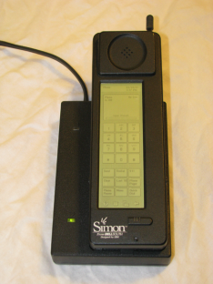
Rise of the Smart Phone
calendar, address book, e-mail
touch screen
on-screen "predictive" keyboard
Simon
1993

Slide 4
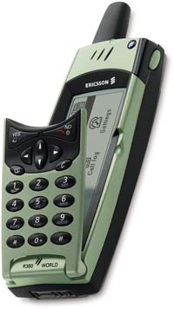

Rise of the Smart Phone
Symbian OS
Ericsson R380
1993
2000

Slide 5
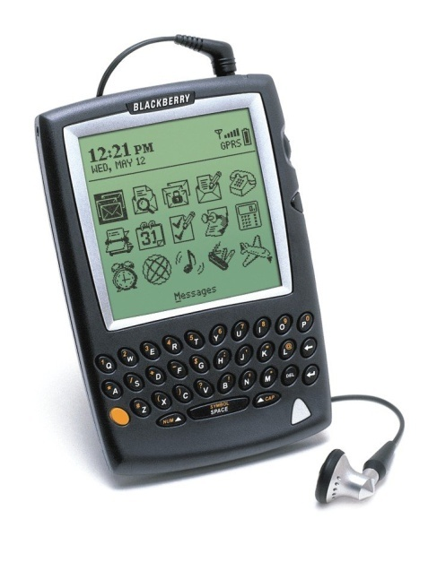
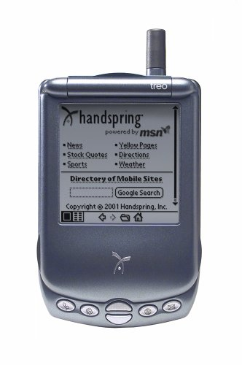
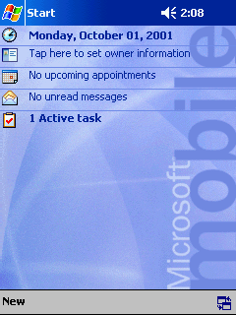

Rise of the Smart Phone
BlackBerry 5810
Blackberry
Windows Pocket PC
Treo
Treo 180
1993
2000
2002

Slide 6
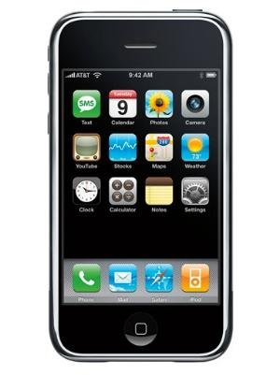

Rise of the Smart Phone
iPhone
1993
2000
2002
2007

Slide 7


Rise of the Smart Phone
iPhone 3G/3GS
Android
App Stores
1993
2000
2002
2007
2008

Slide 8
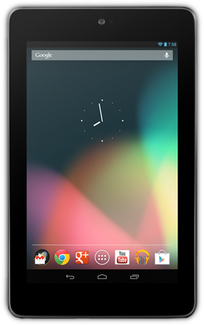
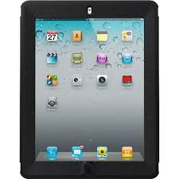
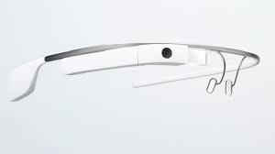
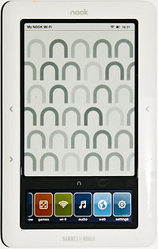
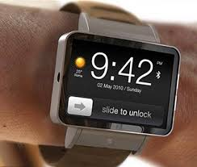

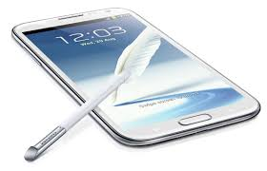
Rise of Mobile Devices
7“ Tablets
10“ Tablets
Google Glass
E-readers
Smartwatch
Phablets
2009
2010
2011
2012
2013
2014

Slide 9
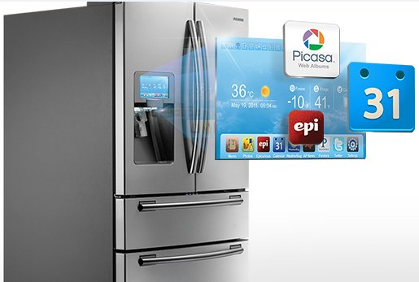
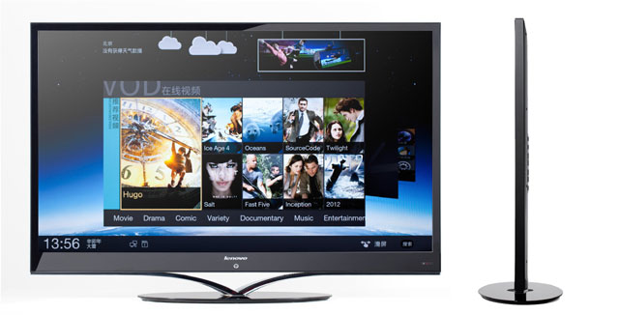
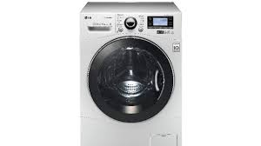

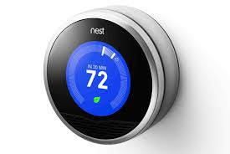
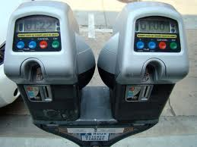

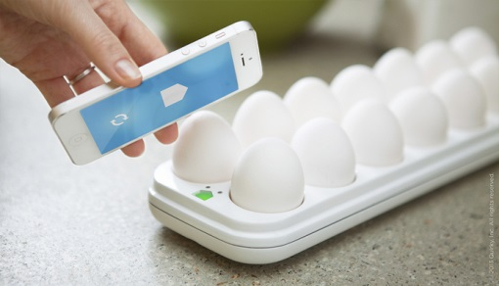
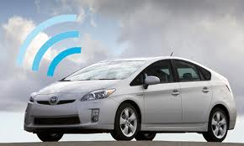
Future - Internet of Things

Slide 10



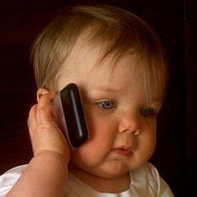


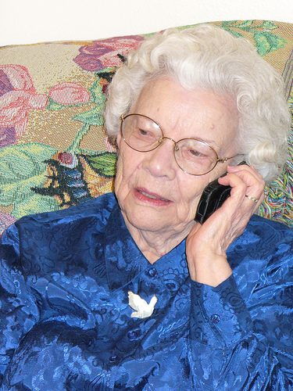
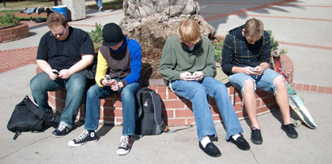
Smart Phone Users

Slide 11






Mobile Device Sensors
A rich set of devices and sensors available
LTE
Bluetooth
GPS
Microphone
Camera
Accelerometer
Notes:
Name all, GSM, GPS, BT, Accellerometer
Tower instead of person
Make names smaller font

Slide 12
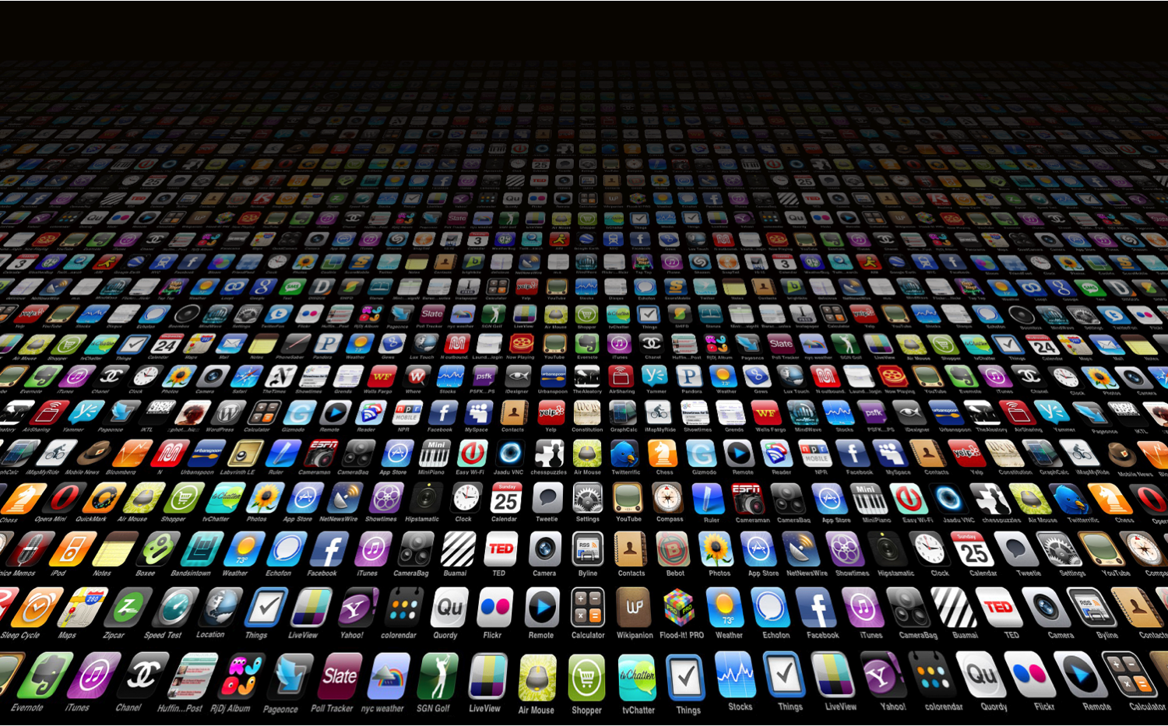











Apps
1.4 million + apps in the Apple App Store
1.4 million + apps in the Google Play Store
100 billion + apps downloaded combined
Notes:
Image taken from: http://blog.teamtreehouse.com/the-business-of-apps

Slide 13



Mobile Operating Systems
Android | iOS | Windows Phone
Java | Objective C | C#
Android SDK | iOS SDK | .NET Framework
Linux | OS X/Darwin | Windows NT

Slide 14
Programming for Mobile OS
Not just learning a programming language and libraries
Need to understand the “lifecycle” of an application
Different components of a single application
Limitations
Resource constrained (memory, disk, CPU)
Battery life
Network latency and connectivity
Screen size
Device heterogeneity
Simple, quick, intuitive, usable

Slide 15
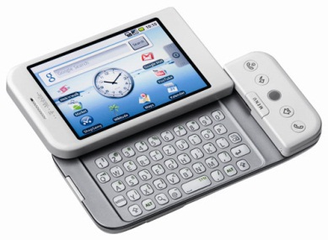
Android
Open platform developed by the Open Handset Alliance
Consortium of 84 companies
Hardware, software, and telecommunication companies
T-Mobile, Sprint, Google, eBay, Qualcomm, Nvidia, TI, Intel, HTC, LG, Sony, Samsung, Motorola
First Android phone released in 2008 (HTC Dream)
Currently holds 82.8% market share as of Q2 2015*
*IDC
Notes:
*http://www.idc.com/prodserv/smartphone-os-market-share.jsp

Slide 16
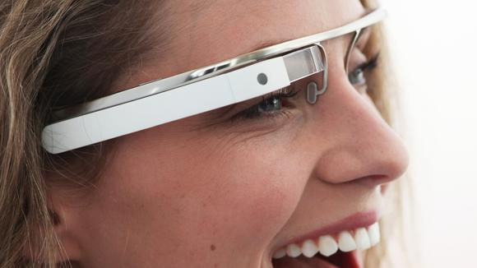
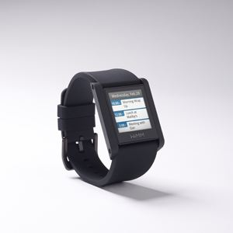
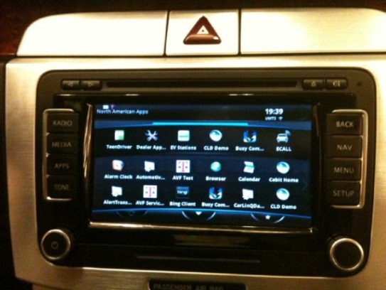

Android as a Platform
Open platform leads to many devices

Slide 17
Why Choose Android?
Good development environment
High market share
Open source (good for research!)
Large number of devices, new devices coming
Apps are typically developed for both Android and iOS
Free to deploy apps
Techniques can be applied across all systems

Slide 18
Some Drawbacks
Software fragmentation
OEM changes, 3rd party APIs
Different hardware on different devices
No update procedure for the system
App pirating

Slide 19
Course Objectives
Provide the opportunity to explore the capabilities of a mobile platform through lectures, homeworks, and a group project
After the course you should:
Be comfortable developing in Android
Have demonstrated your individual abilities through homework assignments
Have demonstrated your ability to work within a group and carry out an idea through various project develop stages
Have applied various principles of usability, design, conventional coding practices, and security

Slide 20
Course Overview
Overview of Android
Using the SDK, development environment, git, first application
Activities, basic UI development, Fragments, Intents
Services, multitasking, and communicating with Activities
Storing data, retrieving data, exposing data to other apps
Interacting with the Internet, how to build efficient apps
Sensors
Security
Advanced Topics
Utilize android developer guide for most of the course
http://developer.android.com/guide/components/index.html

Slide 21
Grading
60% Project
20% Project Design
10% Initial Design
10% Final Design
10% First Prototype (Presentation in class)
15% Second Prototype (Poster Presentation at NYU or AT&T)
15% Final Delivery (Demo to me)
We will be using github to ensure everyone is working equally on the project. I will also ask each individual for a peer review of each of the their group members.

Slide 22
Grading
Everyone MUST contribute EQUALLY to the implementation and CODING of the project
It is NOT ENOUGH to just be involved in the design process, the discussions, and the “GUI”
If it is apparent that you did not contribute to the coding of the project, you be penalized 50% or more for each prototype and the final deliverable

Slide 23
Grading
30% Homeworks
There will be 4 homework assignments (grading rubric)
You MUST turn in something for each assignment, even if late
All aspects count, INCLUDING THE GUI
Late assignment policy
Homeworks are due Sunday night at 11:55 PM
Each person gets 3 late credits
Each person must have a late credit for group assignment
NO EXTRA CREDIT for maintaining late credits

Slide 24
Grading
10% Peer Evaluation, Class Participation, Attendance
Peer Evaluation – for projects, initial fast pitch, possibly presentations
Class Participation – class is boring if I just talk, PARTICIPATE and ASK QUESTIONS
Attendance
Google won’t teach you everything! Attend class
I will be taking attendance. Each person is allowed 2 absences. After this, you will lose credit in this area. I am also planning to track LATE arrivals

Slide 25
Reference Material
There is no book required for this course
Most of the material will come from the Android developer guide http://developer.android.com/index.html
I also have taken some examples from the following book: http://www.bignerdranch.com/book/android_the_big_nerd_ranch_guide
I recommend that book if you would like to purchase a book, but it is not required

Slide 26
Some Notes About the Class
This class should be enjoyable if you put in the work
I am here to help you...email me (I answer)
Do not wait until the last minute on the project
The project is not meant to be easy, it should be a semester long effort of design, coding, and presentations
Do not take this course if you want an easy A
Most of you are graduate students, I expect graduate work

Slide 27
Collaboration/Plagiarism Policy
Homeworks must be done individually and students must turn in their own code
Project teams should work independently
Discussing of general ideas is allowed
Open source code or libraries found online MUST be cited within your project/homework design documents and commented
DO NOT just copy and paste code from a Google search result
https://engineering.nyu.edu/academics/code-of-conduct/academic-dishonesty

Slide 28
Prerequisites
Programming experience, preferably object oriented and Java
Knowledge of operating system concepts
Knowledge of database concepts (SQL)

Slide 29
Icebreaker
Tell us about yourself
Your favorite mobile app and why
Something interesting about yourself that others don’t know or wouldn’t be able to guess
Notes:
adroid

Slide 30
Homework 1
Propose an idea for a mobile app that the class should build
Assignment Goals:
Think of novel mobile applications
Group projects will be selected from here
Learn to pitch an idea in 5 minutes or less
Note: Do not pitch something you don’t want to do! If your project is selected you will be the team leader.

Slide 31
Evaluation Criteria
Originality – Don’t just port existing software, create something new, you are expected to look for related work
Effective Use of Mobile – GPS, always connected, acceleromter, multitouch, etc.
Solution Complexity – Is this a 3-4 person semester long project, algorithms required, some research needed
Problem – Is this app solving a real problem?
Pitch – Was it a good pitch? Did you make me want to choose your app?

Slide 32
How to Pitch an Idea?
Get off to a fast start
Explain the relevance of what you do
Stay at a high level
Listen to the audience reaction
Pitch over and over again (Practice!)

Slide 33
One Minute!
Establish what you do
No one wants to hear your life story and how you got here
Make it short and sweet
We sell software, we teach underprivileged kids, we prevent unhealthy eating habits, etc.

Slide 34
So What?
We use digital signal processing!
So what?
Our product increases the clarity of sounds
For instance, if you’re at a loud event with many conversations going on around you, you will be able to hear what people are saying to you
We provide 128 bit encryption in a portable device using secure hardware!
So what?
It is really difficult to break into our system
For instance, if you’re in a hotel room and want to have a secure telephone conversation with your...

Slide 35
Know Your Audience
Are you speaking to an organization – what is their job/mission?
Technical, non-technical, executives – your pitch will need to change depending on the type of audience. Learn their track record, history, boards they may be on, etc.
Find connections, hooks, etc. to make the pitch powerful and meaningful to the audience
Ask them in advanced what they are expecting, what made them want to meet, special topics they want to hear about etc.

Slide 36
Catalyze Fantasy
How do you convince someone the opportunity is big?
Most people use numbers, studies, etc.
“62% of companies will be using mobile devices...”
Try to make it more intuitive
Everyone needs....
All other solutions are broken due to....
Our solution solves this and more...
Lots of companies will need to buy this product!

Slide 37

Art of the Start
What does it take to turn ideas into action?
What are the elements of a perfect pitch?
How do you win the war for talent?
How do you establish a brand without bucks?
These are some of the issues everyone faces when starting or revitalizing any undertaking....
For short excerpt see: http://www.forbes.com/ceonetwork/2004/09/10/0910gkbook.html

Slide 38
Homework 1 – Fast Pitch
5/5/30
5 Slides
3 Minutes (and 2 minutes for questions!)
30 point font or larger

Slide 39
5 Slides for Pitch
Title (try to be catchy)
The Problem
Competition (why don’t they solve it?)
Your Solution
Your Solution

Slide 40
Tips for Slides
One point per slide. Bullets and figures to support
Slides to lead not to read
Use common simple fonts
Animate your body and NOT your slides
Build bullets
Only one level of bullets
Add visual aids

Slide 41
Project Examples
Indoor Navigation
Used Wi-Fi signal and step detection algorithm to track indoor location
Ping
Short location based “Pings” around your area
LegitHub
Mobile alternative to Craigslist with security in mind
Sandroid
Disabled sensative API calls on applications

Slide 42
Project Examples
StagePlay
Converted play scripts into comic-like animations
Clipboard++
Shares your clipboard across multiple devices
QBuster
Mobile payment application to avoid lines at retail stores
SelfieCharades
Two-player charades game using selfies
QuitIt
App to help you stop using other addictive apps

Slide 43
Computer Science Conferences
If interested in the research side of things, there are a lot of CS conferences related to mobile computing and apps
Mobisys
HotMobile
MobiCom
UbiComp

